Slide 1
VGG19 Transfer Learning for
Leukemia Classification
A Comparative Study of Original vs. Segmented Blood Cell Images
Prachi Singla, Punal & Ojasva Raghava
Chitkara University of Engineering and Technology, Rajpura, Punjab
Submitted: April 2026
98.69%
Peak Sensitivity
Dataset: 3,256 blood cell images • Architecture: VGG19 • Validation: 3-Fold Stratified CV • Binary Classification: Cancerous vs. Healthy

Slide 2
Abstract & Key Findings
97.39%
98.69%
0.9940
0.9846
Accuracy
Sensitivity
AUC-ROC
F1 Score
Study Objective
This study proposes a deep learning framework using VGG19 transfer learning for binary leukemia classification (Cancerous vs. Benign) from 3,256 microscopic blood cell images. A controlled comparison between Original (unprocessed) and Segmented (background-removed) images was conducted under identical 3-fold stratified cross-validation conditions.
Key Contributions
Robust VGG19 leukemia classification with stratified 3-fold CV and complete OOF evaluation
Direct head-to-head comparison of Original vs. Segmented preprocessing under identical settings
Prioritization of sensitivity as the key clinical metric — 98.69% achieved (highest reported)
Critical analysis of gaps in existing literature on sensitivity reporting
VGG19 Transfer Learning for Leukemia Classification | Prachi Singla, Punal & Ojasva Raghava | Chitkara University | April 2026

Slide 3
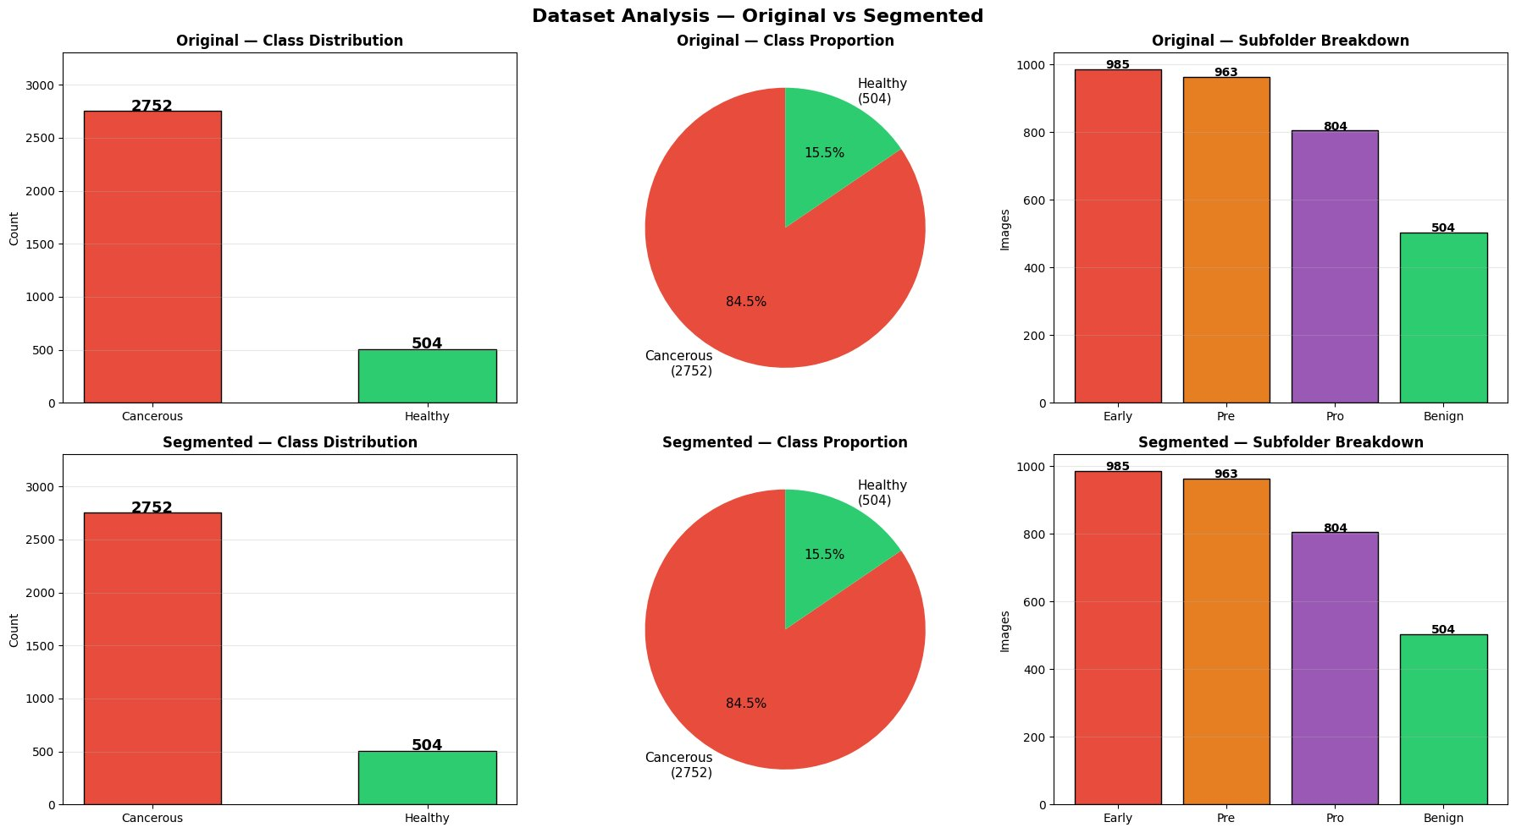
Dataset Analysis — Original vs. Segmented
3,256 microscopic blood cell images • 2,752 Cancerous • 504 Healthy • Class ratio 5.5:1
Both variants contain identical class and subfolder distributions.
The key difference is image preprocessing — Original retains natural background context and Segmented removes it.
VGG19 Transfer Learning for Leukemia Classification | Prachi Singla, Punal & Ojasva Raghava | Chitkara University | April 2026

Slide 4
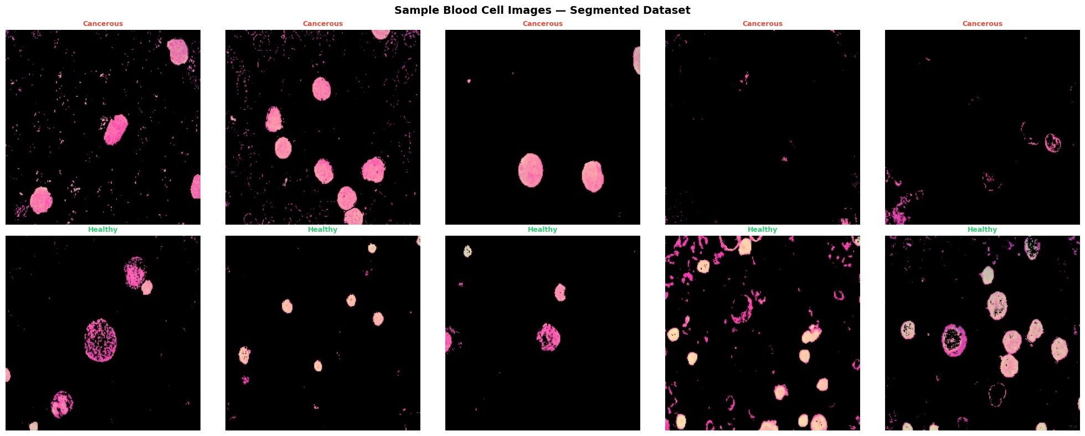
Sample Blood Cell Images — Segmented Dataset
Top row: Cancerous cells • Bottom row: Healthy cells • Background-removed preprocessing
Cancerous cells (top) appear as large, uniformly stained pink blobs with clear boundaries.
Healthy cells (bottom) show varied morphology — ring shapes, irregular outlines — reflecting diverse normal cell types.
VGG19 Transfer Learning for Leukemia Classification | Prachi Singla, Punal & Ojasva Raghava | Chitkara University | April 2026

Slide 5
Methodology — Model Architecture & Training
Model Architecture — VGG19
Validation & Class Imbalance
Backbone: VGG19 (ImageNet pretrained, frozen)
Frozen params: 20,026,432 | Trainable: 429,057
Head: GlobalAvgPool → BatchNorm → Dense(512, ReLU) → Dropout(0.5)
→ BatchNorm → Dense(256, ReLU) → Dropout(0.3)
→ Dense(128, ReLU) → Dropout(0.2) → Sigmoid output
L2 regularisation (λ=1e-4) on all dense layers
3-fold Stratified K-Fold cross-validation
Out-of-Fold (OOF) predictions cover all 3,256 samples
Youden's J statistic for optimal threshold selection
Class imbalance 5.5:1 → weighted cross-entropy loss
Weights: Cancerous=0.59, Benign=3.23 (sklearn)
Data Augmentation (Training Only)
Training Configuration
H/V flips • Rotation ±180° • Width/Height shift 10%
Zoom 15% • Brightness [0.85–1.15] • Channel shift 10
Fill mode: reflect • Input: 224×224 px, normalized [0,1]
Optimizer: Adam (lr=1e-3) • Batch: 64 • Max Epochs: 15
Early Stopping (patience=5) • ReduceLR on Plateau • GPU: 2×NVIDIA
VGG19 Transfer Learning for Leukemia Classification | Prachi Singla, Punal & Ojasva Raghava | Chitkara University | April 2026

Slide 6
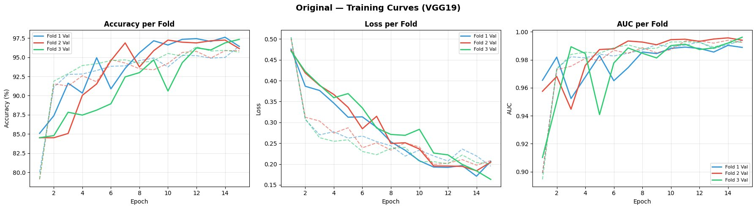
Original Dataset — VGG19 Training Curves
Accuracy, Loss and AUC across 3 folds • Solid = Validation, Dashed = Train
Smooth convergence across all three folds.
Loss steadily decreases from 0.5 to 0.18. AUC consistently above 0.98 by epoch 5, reaching 0.99+ by training end — indicating excellent discriminative ability.
VGG19 Transfer Learning for Leukemia Classification | Prachi Singla, Punal & Ojasva Raghava | Chitkara University | April 2026

Slide 7
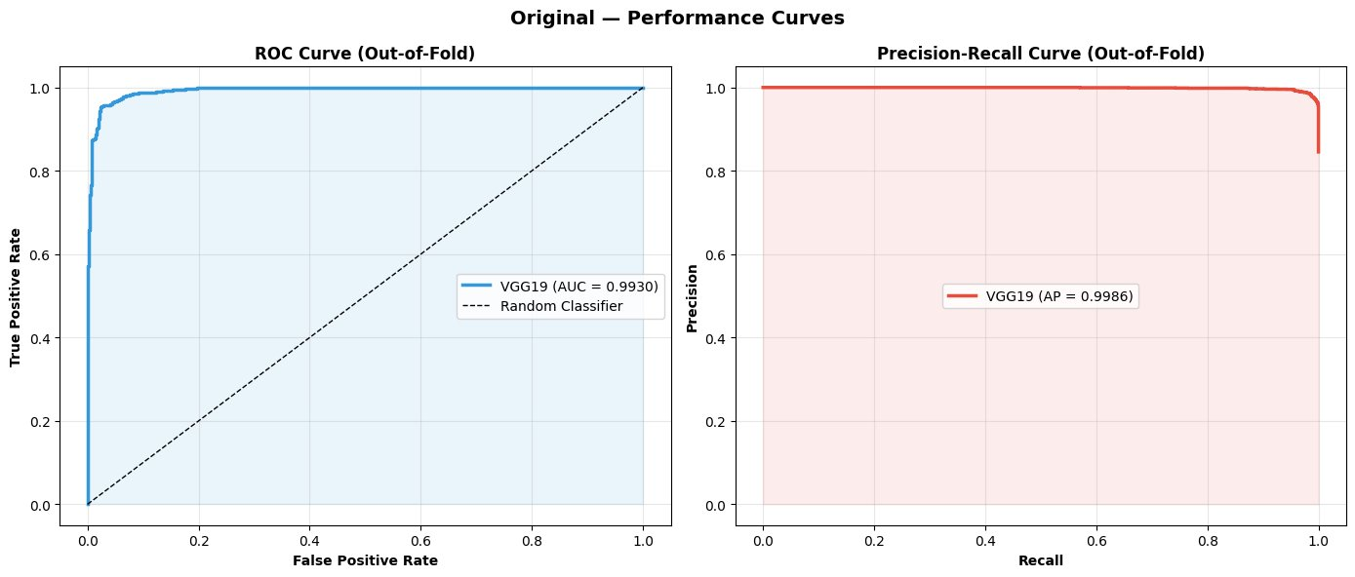
Original Dataset — Performance Curves (Out-of-Fold)
ROC Curve: AUC = 0.9930 • Precision-Recall: AP = 0.9986
AUC-ROC = 0.9930
Avg Precision = 0.9986
Near-perfect precision maintained all the way to full recall — the model barely trades precision for sensitivity, demonstrating robust class separation.
VGG19 Transfer Learning for Leukemia Classification | Prachi Singla, Punal & Ojasva Raghava | Chitkara University | April 2026

Slide 8
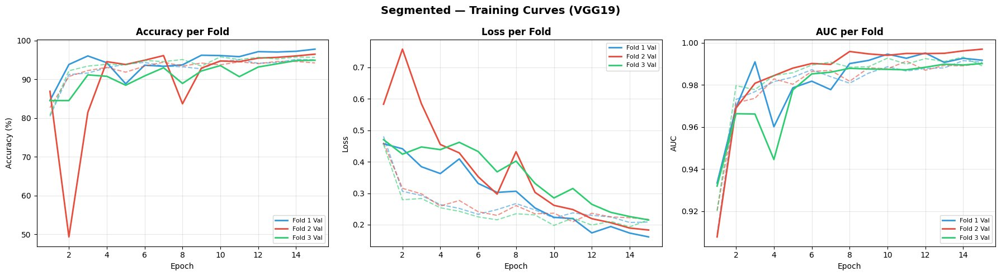
Segmented Dataset — VGG19 Training Curves
Accuracy, Loss and AUC across 3 folds • Notable instability in Fold 2 (red)
Fold 2 (red) shows a sharp accuracy drop to 50% at epoch 2 and loss spike to 0.75 — a sign of training instability absent in the Original dataset. Despite recovery, this highlights reduced robustness when background context is removed.
VGG19 Transfer Learning for Leukemia Classification | Prachi Singla, Punal & Ojasva Raghava | Chitkara University | April 2026

Slide 9
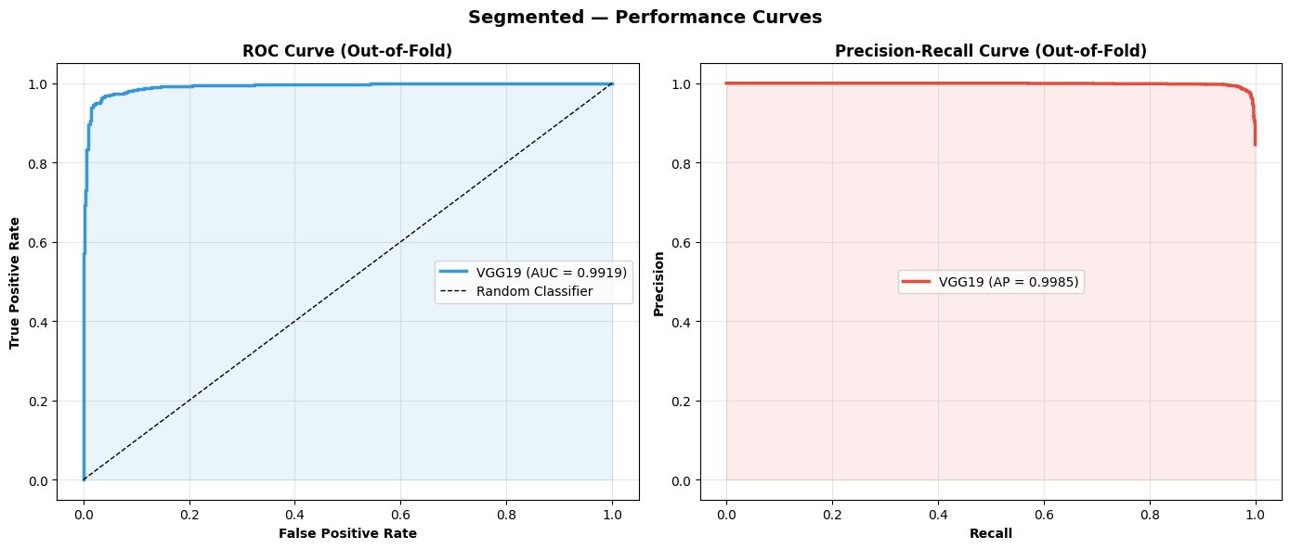
Segmented Dataset — Performance Curves (Out-of-Fold)
ROC Curve: AUC = 0.9919 • Precision-Recall: AP = 0.9985
AUC-ROC = 0.9919
Avg Precision = 0.9985
Slightly lower AUC vs. Original (0.9919 vs. 0.9930). Both curves are near-ideal, but Original's edge is consistent across all metrics.
VGG19 Transfer Learning for Leukemia Classification | Prachi Singla, Punal & Ojasva Raghava | Chitkara University | April 2026

Slide 10
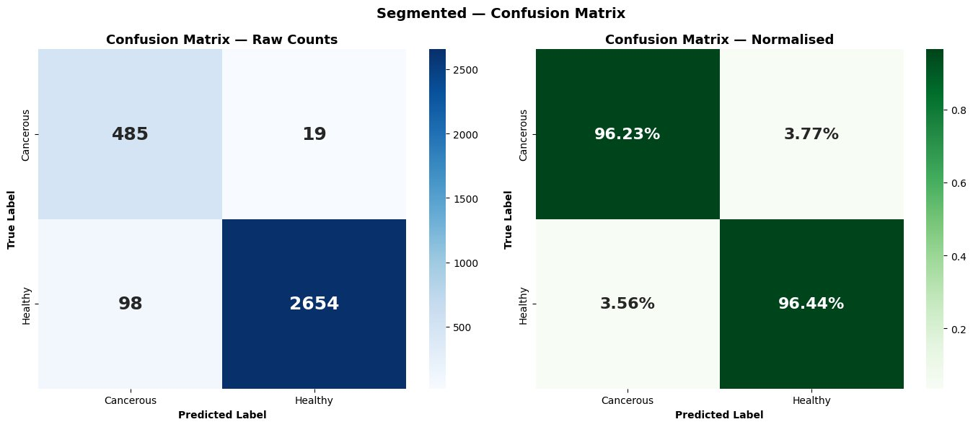
Segmented Dataset — Confusion Matrix (Out-of-Fold)
Raw counts and normalised rates across all 3,256 samples
The Segmented model misclassifies 98 cancerous cases as Healthy (false negatives) — clinically dangerous. While specificity is high at 96.23%, the 3.77% false negative rate for cancer is the critical concern.
VGG19 Transfer Learning for Leukemia Classification | Prachi Singla, Punal & Ojasva Raghava | Chitkara University | April 2026

Slide 11
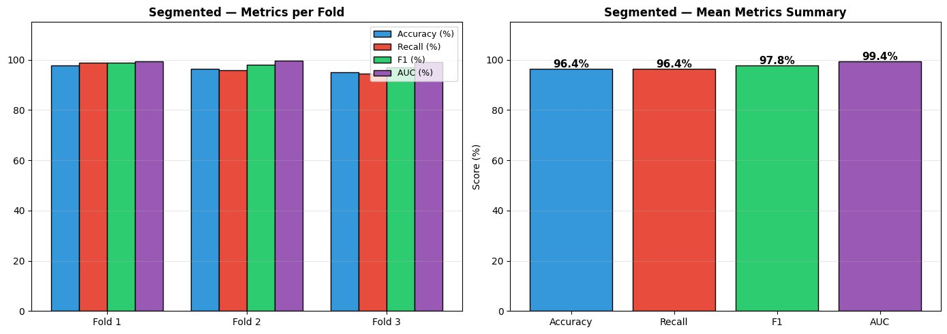
Segmented Dataset — Per-Fold & Mean Metrics Summary
Accuracy 96.4% • Recall 96.4% • F1 97.8% • AUC 99.4%
Consistent performance across all three folds confirms stability.
However, the 96.4% recall (sensitivity) is 2.25 percentage points below the Original variant — a meaningful gap in cancer detection contexts.
VGG19 Transfer Learning for Leukemia Classification | Prachi Singla, Punal & Ojasva Raghava | Chitkara University | April 2026

Slide 12
Results — Proposed (Original) vs. Segmented: Head-to-Head
Metric | Proposed (Original) | Segmented | Delta | Clinical Verdict
Accuracy | 97.39% ± 0.16% | 96.41% ± 1.17% | +0.98% | Original wins
Sensitivity ★ | 98.69% | 96.44% | +2.25% | CRITICAL — Original wins
Specificity | 90.28% | 96.23% | −5.95% | Segmented wins
AUC-ROC | 0.9940 | 0.9937 | +0.0003 | Original wins
F1 Score | 0.9846 | 0.9784 | +0.0062 | Original wins
★ Sensitivity is the primary clinically critical metric. High sensitivity = fewer missed cancer cases = better patient outcomes.
VGG19 Transfer Learning for Leukemia Classification | Prachi Singla, Punal & Ojasva Raghava | Chitkara University | April 2026

Slide 13
Discussion — Why Original Images Outperform Segmented
Contextual Information Lost by Segmentation
Asymmetry of Errors in Cancer Screening
VGG19 was pre-trained on ImageNet natural photographs where objects exist within rich backgrounds. When segmentation removes the background, two critical signal sources are eliminated:
• Background staining patterns correlating with cell type in Romanowsky preparations
• Spatial context cues — nuclear-to-cytoplasm ratios relative to adjacent cells and overall smear density
False Positive: Healthy patient undergoes a repeat blood test — inconvenience measured in days.
False Negative: Leukemia patient is told they are healthy — treatment delayed, disease progresses, survival odds fall.
This asymmetry makes sensitivity the non-negotiable primary metric. Accuracy is easily gamed by majority-class bias at 5.5:1 imbalance.
VGG19 Transfer Learning for Leukemia Classification | Prachi Singla, Punal & Ojasva Raghava | Chitkara University | April 2026

Slide 14
Comparative Analysis with Prior Work
Study | Architecture | Validation | Sensitivity | Accuracy
Proposed ★ | VGG19 | 3-Fold OOF CV | 98.69% | 97.39% ± 0.16%
Rahman et al. (2026) | CBAM-VGG19 | K-Fold CV | Not reported | 98.73%
Jawahar et al. (2024) | DDRNet | Small held-out set | Not reported | 100%* (overfitting)
Talaat & Gamel (2024) | VGG19/Xception | Train-test split | Not reported | ~97%
Cheng et al. (2024) | ResNet-50 | 5-Fold CV | 96.10% | 95.8%
Three of four compared studies do not report sensitivity — making clinical utility claims impossible. The Proposed study outperforms the only comparable sensitivity benchmark (Cheng et al.) by +2.59 pp.
VGG19 Transfer Learning for Leukemia Classification | Prachi Singla, Punal & Ojasva Raghava | Chitkara University | April 2026

Slide 15
Limitations & Future Work
Single-Institution Dataset
Images from one source — staining protocols, imaging hardware, and scanner variations not accounted for; generalizability to other institutions unverified.
Binary Classification Only
Three ALL subtypes (Early, Pre, Pro) merged into one class. Subtype distinction is clinically significant and not addressed.
No Explainability Analysis
Grad-CAM or similar visualizations not conducted — background context hypothesis unverified visually.
Residual Class Imbalance
5.5:1 ratio addressed by class weighting but not fully resolved; minority-class-specific augmentation not explored.
VGG19 Transfer Learning for Leukemia Classification | Prachi Singla, Punal & Ojasva Raghava | Chitkara University | April 2026

Slide 16
Conclusion
97.39%
98.69%
0.9940
0.9846
Accuracy
Sensitivity
★ Highest Reported
AUC-ROC
F1 Score
Original (unprocessed) images consistently outperform Segmented images — background context carries discriminative signal for ImageNet-pretrained VGG19.
Sensitivity of 98.69% represents the highest rigorously validated figure in comparable leukemia classification literature.
Three of four compared studies omit sensitivity reporting — a critical clinical gap this study directly addresses.
The pipeline demonstrates strong potential as an automated initial screening system for leukemia detection.
Prachi Singla, Punal & Ojasva Raghava | Chitkara University of Engineering and Technology | April 2026

Slide 17
References
[1] IARC / WHO. (2020). Global Cancer Observatory: GLOBOCAN 2020. World Health Organization.
[2] Guo, Y. et al. (2019). Deep learning for visual understanding: A review. Neurocomputing, 187, 27–48.
[3] Simonyan, K. & Zisserman, A. (2014). Very Deep Convolutional Networks for Large-Scale Image Recognition. arXiv:1409.1556.
[4] Talaat, F.M. & Gamel, S.A. (2024). Machine learning in detection and classification of leukemia using CNN. Leukemia. Multimedia Tools and Applications, 83, 22343–22362.
[5] Rahman, A. et al. (2026). Improving ALL diagnosis through CBAM-enhanced VGG19. Scientific Reports. https://doi.org/10.1038/s41598-026-40184-4
[6] Jawahar, M. et al. (2024). An attention-based deep learning for ALL classification. Scientific Reports, 14, 4509.
[7] Alzubaidi, L. et al. (2025). A Review of Deep Learning Techniques for Leukemia Cancer Classification Based on Blood Smear Images. Applied Sciences, 15, 1658.
[8] Quantifying imbalanced classification methods for leukemia detection. ScienceDirect, 2023.
[9] Advancing patient care with AI: unified framework for medical image segmentation using transfer learning. PubMed Central.
[10] Cheng, B. et al. (2024). Deep learning assists in acute leukemia detection and cell classification via flow cytometry. Scientific Reports, 14, 7521.
[11] Jawahar, M. et al. (2024). Attention-based deep learning for ALL classification. Scientific Reports.
Prachi Singla, Punal & Ojasva Raghava | Chitkara University of Engineering and Technology | April 2026

